Slide 1
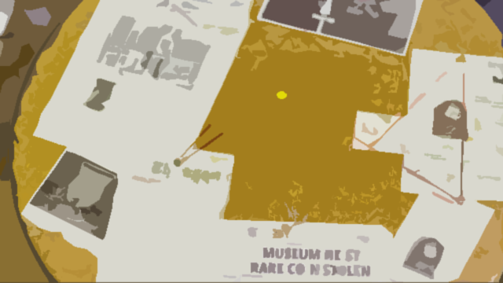
Bomb Defusal
A Cyber Escape Room
Presentation for Gamemasters

Slide 2
Story line
Iranian terrorist cell managed to penetrate to Ariel University
The terrorists hided a bomb somewhere inside the “Low Campus”
YOU ARE THE BEST CYBER TEAM WE’VE GOT. PLEASE HELP US FIND AND DEFUSE THE BOMB.

Slide 3

Indicates future password

Slide 4




Main
Hidden Port
Hidden Wi-Fi
Hidden Broadcast
Mysterious File

Slide 5
Discovery Puzzles – Hidden Port
The ‘Hidden Port’ will be found by nmap on the main server
The server will listen to a singular port which was implied (66666)
Once client has connected via telnet to the server through this port, it will ask him a riddle

Slide 6
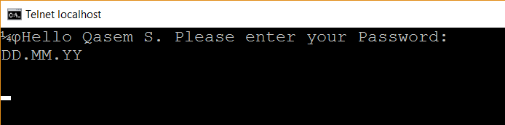
Standalone Puzzle - Hidden Port’s Riddle
Hello Qasem S, Please enter your password:
DD.MM.YY
Wrong answer. Please try again.
Answer: 11.03.57
The answer will print:
Hello Mr. Soleimani. Your RDP details are:
Username: X
Password: X

Slide 7
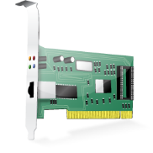

RDP to the server
Network Card
Hidden Files

Slide 8
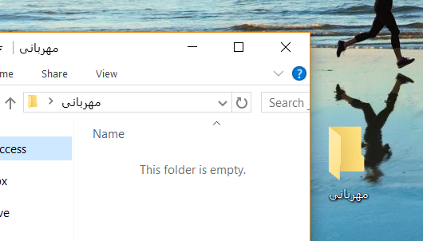
Standalone Puzzle - Hidden Files
3 Folders – Persian titled
The folder will look empty
There will be hidden files inside – Persian emails
The emails in the folder will lead them to the library by map.

Slide 9
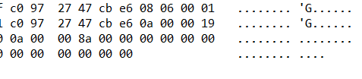
Discovery Puzzles – Hidden Broadcast
The ‘Hidden Broadcast’ will be found by wireshark, sniffing lab
The server will send suspicious broadcast messages that include a packet with the message:
“Bomb”
“Iran”
Persian text
The packet will contain a suspicious hexa including IP address of a new web ‘Private Server’.

Slide 10
Discovery Puzzles – Web Private Server
The ‘Private Server’ will listen to port 80 (found by nmap).
The packet will contain a suspicious hexa including IP address of a new ‘Private Server’.
On the web server, there will be a library map with a specific information
Specific book

Slide 11
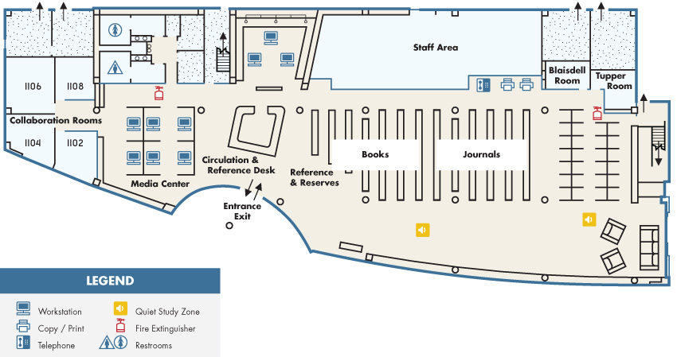
Standalone Puzzle – The Library
Disk on key
Key 1 – QR Code
Clue for Flow2

Slide 12

Code Puzzle – Private Server
Brute Error! Only 5 letters, including only numbers and small letters

Slide 13

Hexa Stego Puzzle

Slide 14
Discovery Puzzles – Hidden Wifi
The ‘Hidden Wifi’ network will be found by Wifi Analyzer, sniffing main room
The SSID and WPA password will be found by X

Slide 15
Standalone Puzzle – Mysterious File
The ‘Mysterious File’ will be given to the participants by the Gamemasters in the beginning
It will include X
To solve the riddle they will have to do X
The answer will be X

Slide 16
Tools
IRC + Scorebot

